Slide 1
Project Assignment – Regression Analysis
David Lienkamp, Sevval Sagir, Raphael Sommer

Slide 2
Relevant parameters
 | Acceleration [sec.] | Maximum Speed [km/h] | Fuel Consumption [l/100km] | Price [€]
Cylinders
Valves/Cylinder
Displacement [cc]
Turbo
Power [hp]
Max Torque [nm]
Length [mm]
Width [mm]
Height [mm]
Weight [kg]
Trunk Volume [l]
Maximum Speed [km/h]

Slide 3
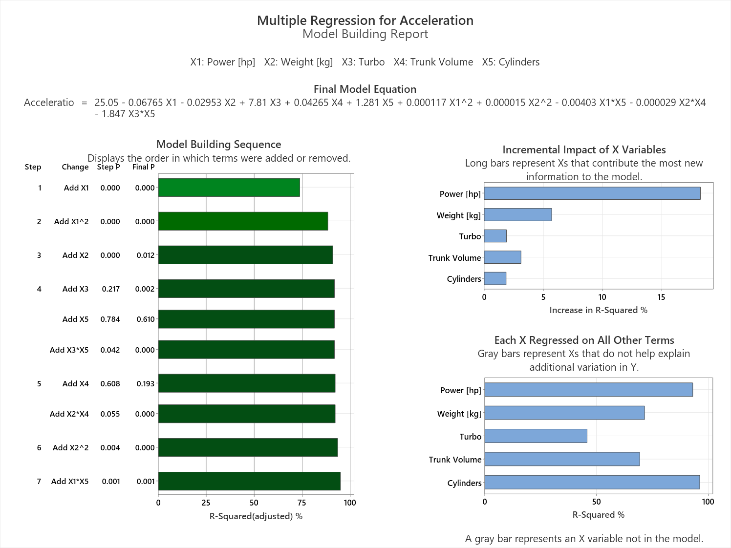
Notes:
The bar chart shows a comparison of the median tank volume between conventional and hybrid electric cars. Conclusion: Hybrid electric cars tend to have a slightly larger median tank volume than conventional cars.

Slide 4
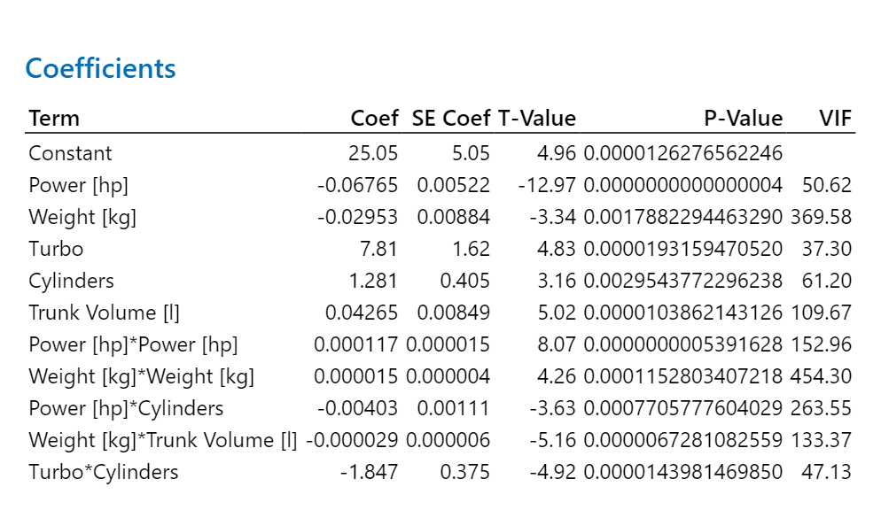
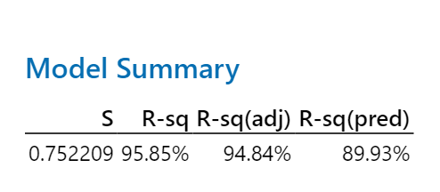
Notes:
The histogram shows the distribution of the length between conventional and electric cars. Conclusion: Electric cars tend to be longer than conventional cars, with their lengths more consistently clustered around a higher average.

Slide 5
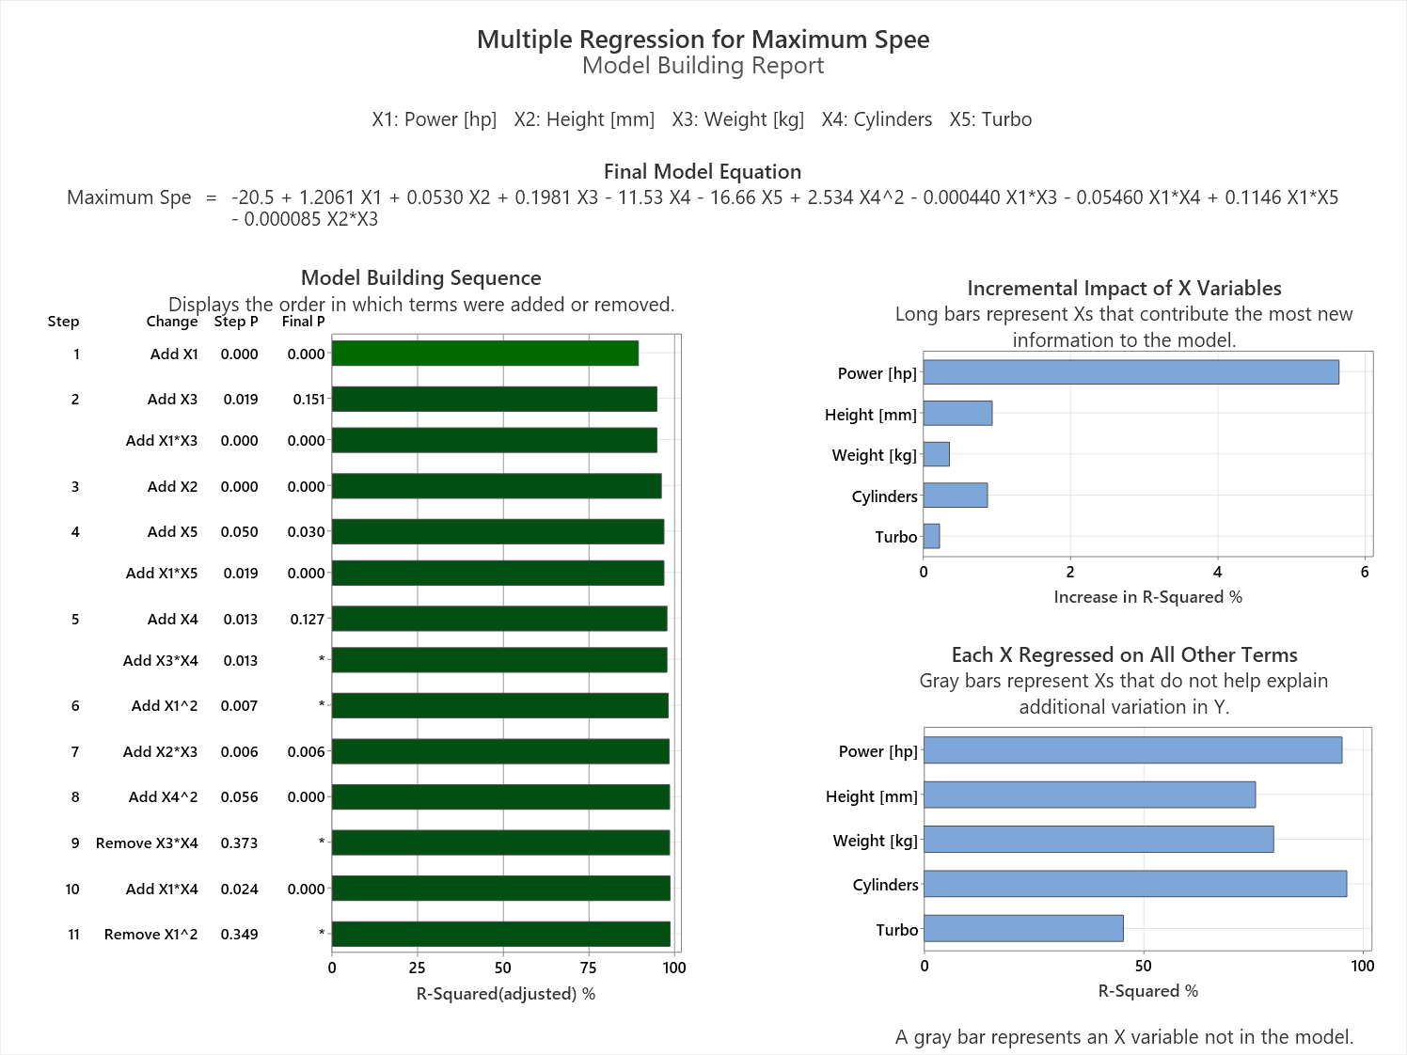
Notes:
The bar chart shows a comparison of the median tank volume between conventional and hybrid electric cars. Conclusion: Hybrid electric cars tend to have a slightly larger median tank volume than conventional cars.

Slide 6
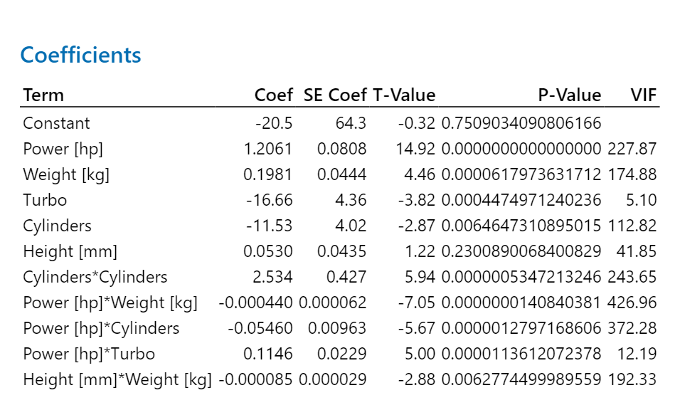
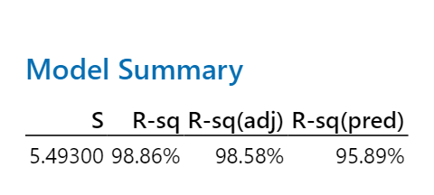
Notes:
The histogram shows the distribution of the length between conventional and electric cars. Conclusion: Electric cars tend to be longer than conventional cars, with their lengths more consistently clustered around a higher average.

Slide 7
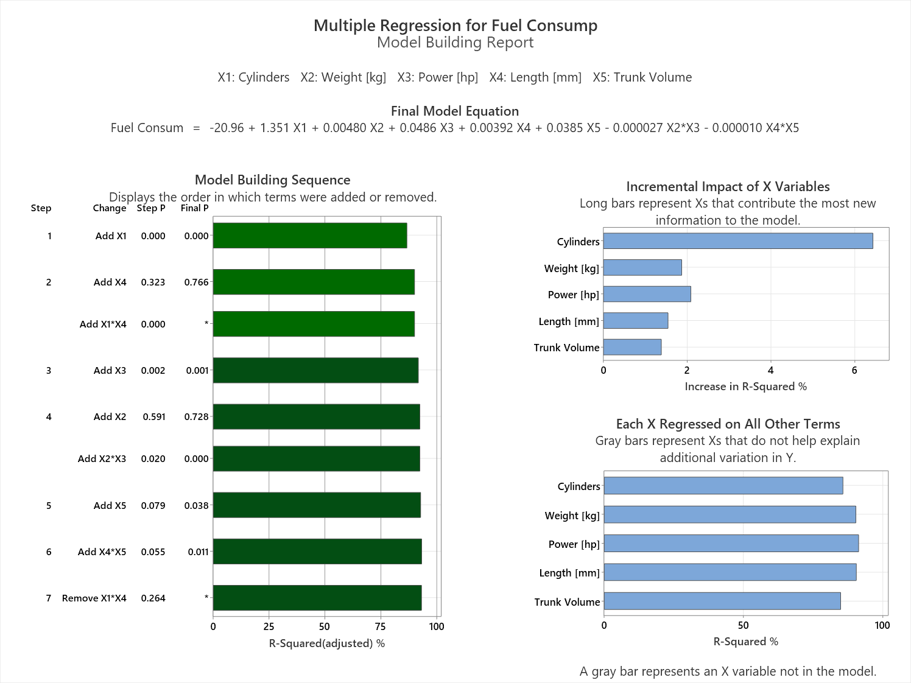
Notes:
The bar chart shows a comparison of the median tank volume between conventional and hybrid electric cars. Conclusion: Hybrid electric cars tend to have a slightly larger median tank volume than conventional cars.

Slide 8
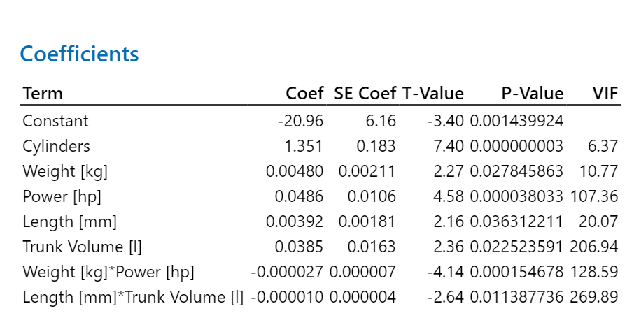
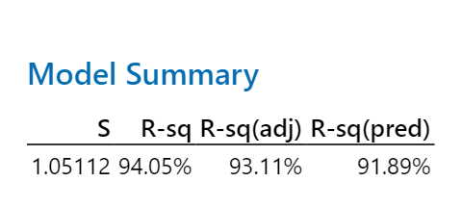
Notes:
The histogram shows the distribution of the length between conventional and electric cars. Conclusion: Electric cars tend to be longer than conventional cars, with their lengths more consistently clustered around a higher average.

Slide 9
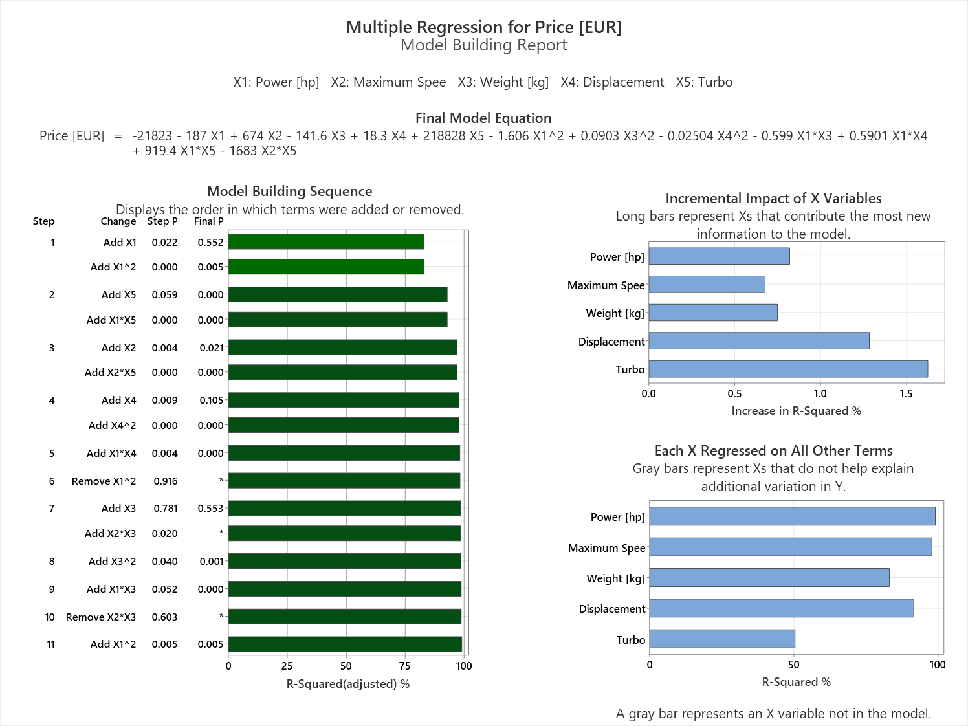
Notes:
The bar chart shows a comparison of the median tank volume between conventional and hybrid electric cars. Conclusion: Hybrid electric cars tend to have a slightly larger median tank volume than conventional cars.

Slide 10
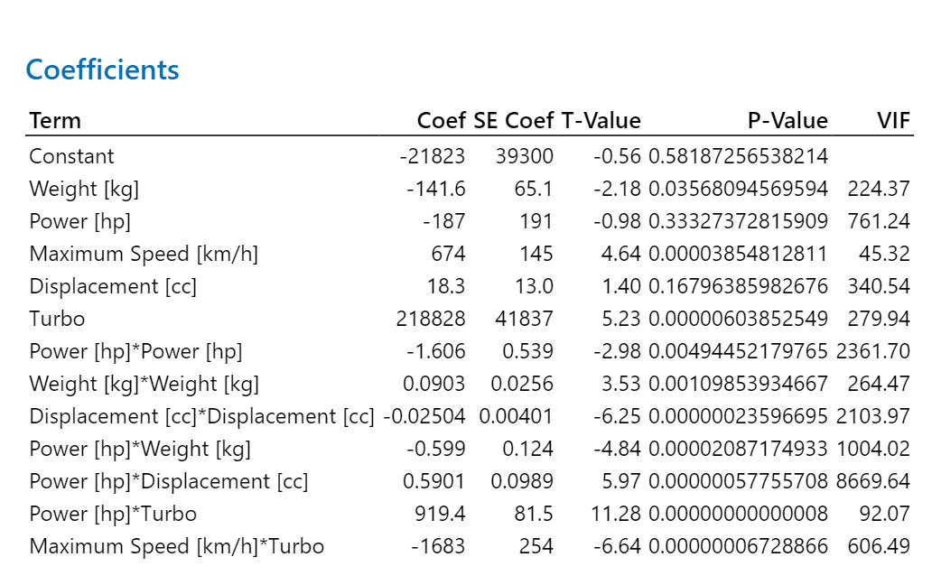

Notes:
The histogram shows the distribution of the length between conventional and electric cars. Conclusion: Electric cars tend to be longer than conventional cars, with their lengths more consistently clustered around a higher average.

Slide 11
Model‘s predictions
 | Acceleration [sec.] | Maximum Speed [km/h] | Fuel Consumption [l/100km] | Price [€]
Car #1 | 12.7 | 186 | 6.2 | 18220
Car #2 | 3.8 | 332 | 22.4 | 264971
Car #3 | 11.6 | 187 | 7.2 | 12812
Car #4 | 12.8 | 184 | 6.6 | 15769
Car #5 | 9.2 | 210 | 6.3 | 23797

